Slide 1
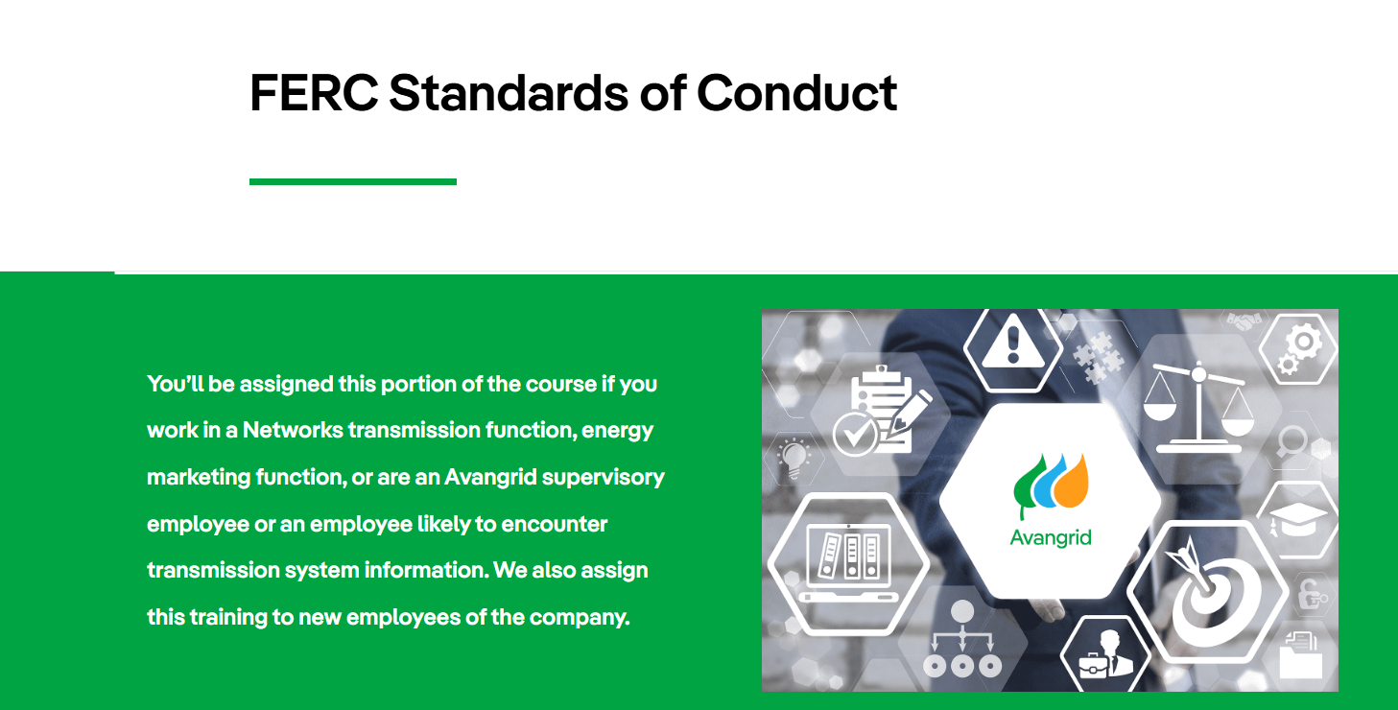

Slide 2
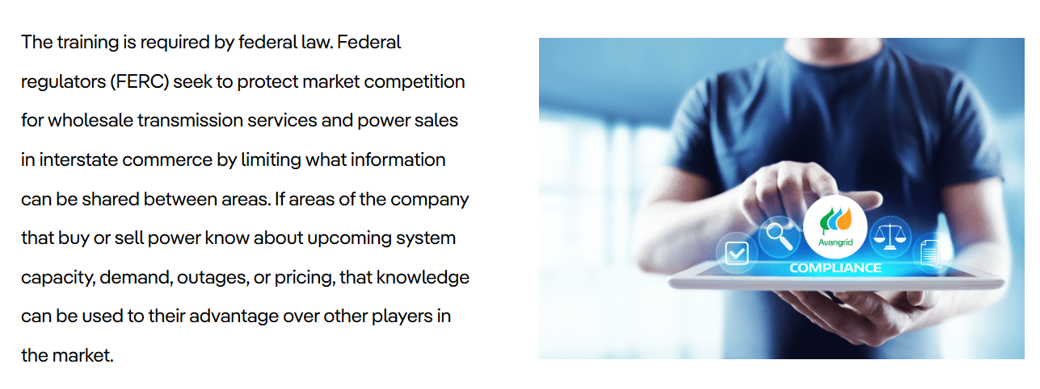
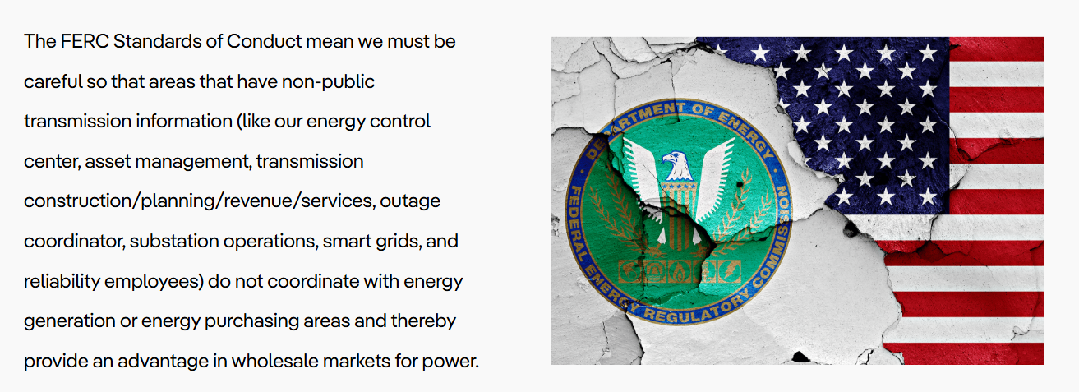

Slide 3
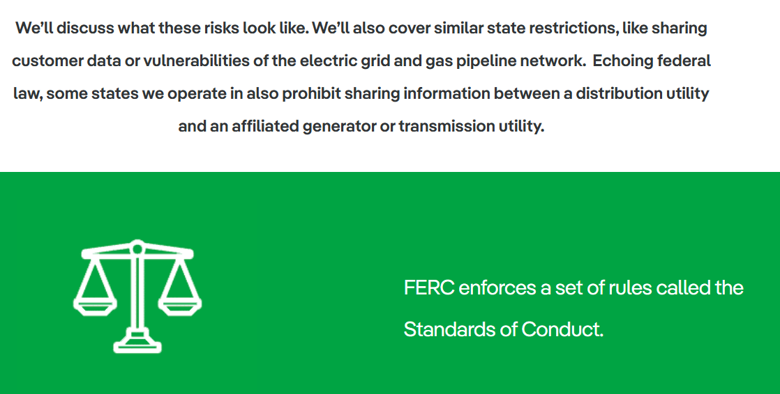
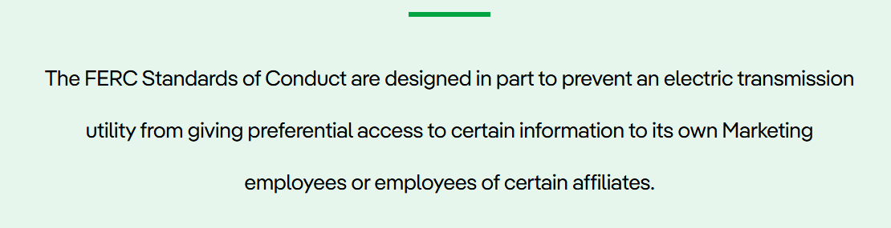

Slide 4


Slide 5
Avangrid Networks
Andrew Jacobs
Networks Chief Compliance Officer
Phone: ( 203)-499-2240
Email: andrew.jacobs@avangrid.com
United Illuminating, Central Maine Power, MEPCO, NECEC, RG&E, and NYSEG
Jason Rauch
Coordinating Compliance Manager
Phone: 207-816-0400
Email: jason.rauch@avangrid.com

Slide 6


Slide 7
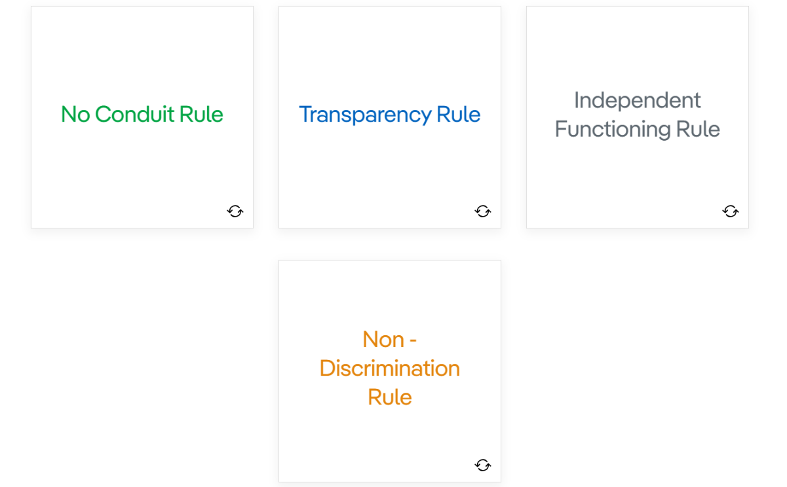
If Avangrid discloses Non-Public Transmission Information to its Marketing employees, it must immediately post the same information on its public website so that all industry market participants have equal access to the information.
Transmission companies, such as Avangrid, are prohibited from using anyone as a conduit for the disclosure of Non-Public Transmission Information to its Marketing employees.
Avangrid's personnel that commonly have Non-Public Transmission Information must work separately and independently from its Marketing employees.
Avangrid must treat all transmission customers, affiliated or non-affiliated, in the same manner, and cannot operate its transmission system to give preference to its Marketing employees or to an affiliate.

Slide 8
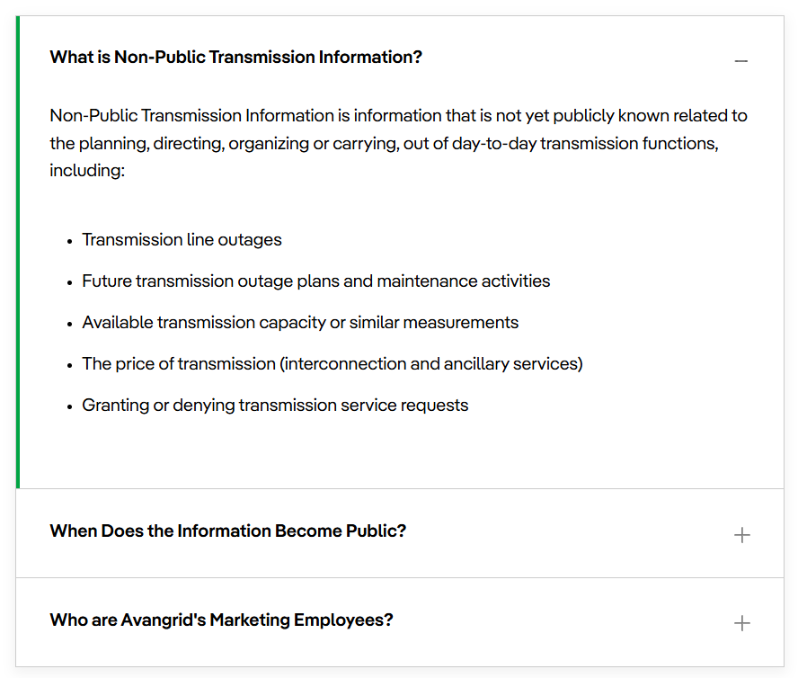

Slide 9
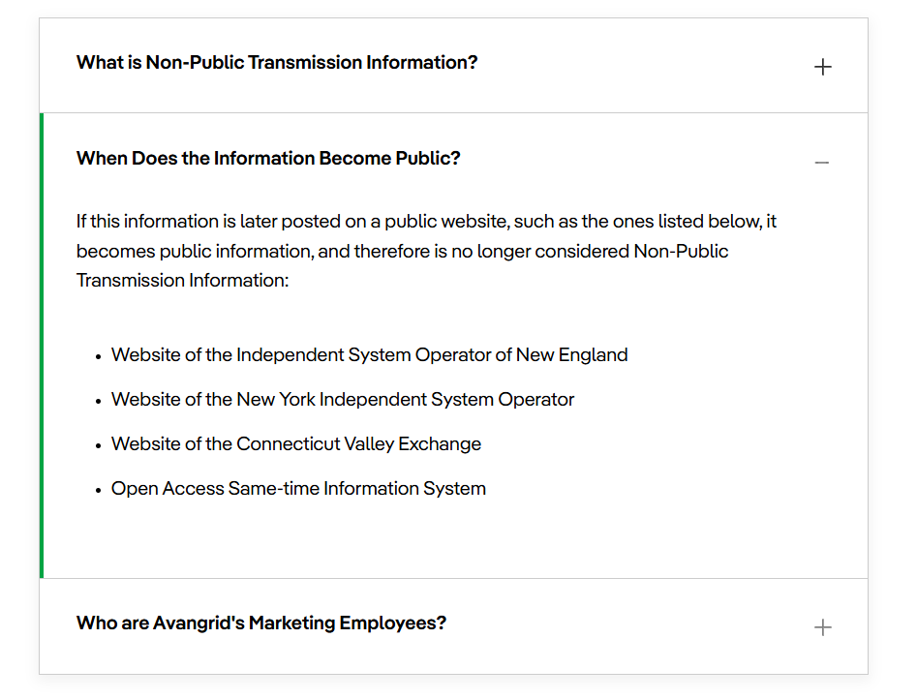

Slide 10
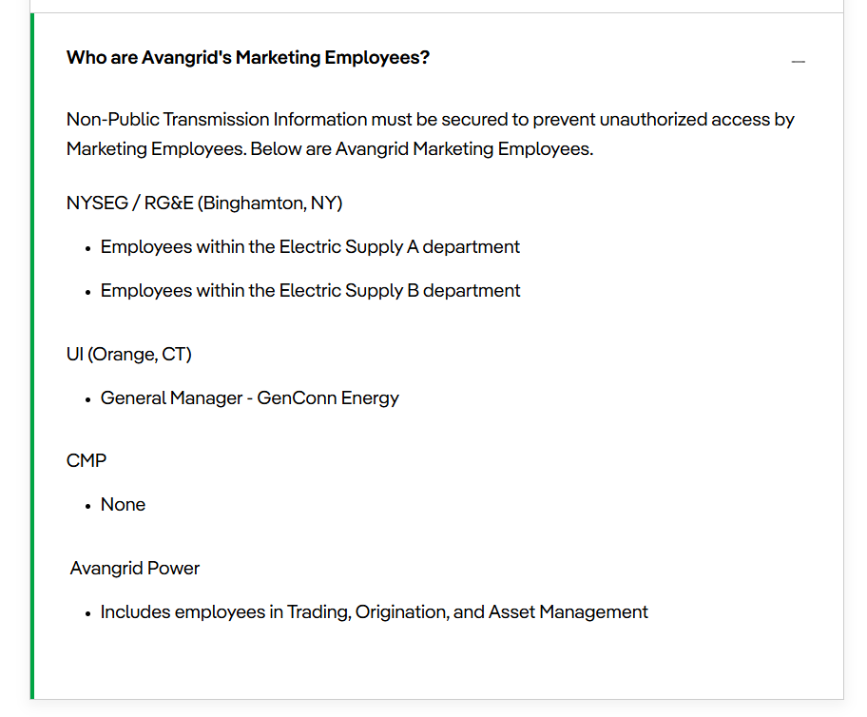

Slide 11
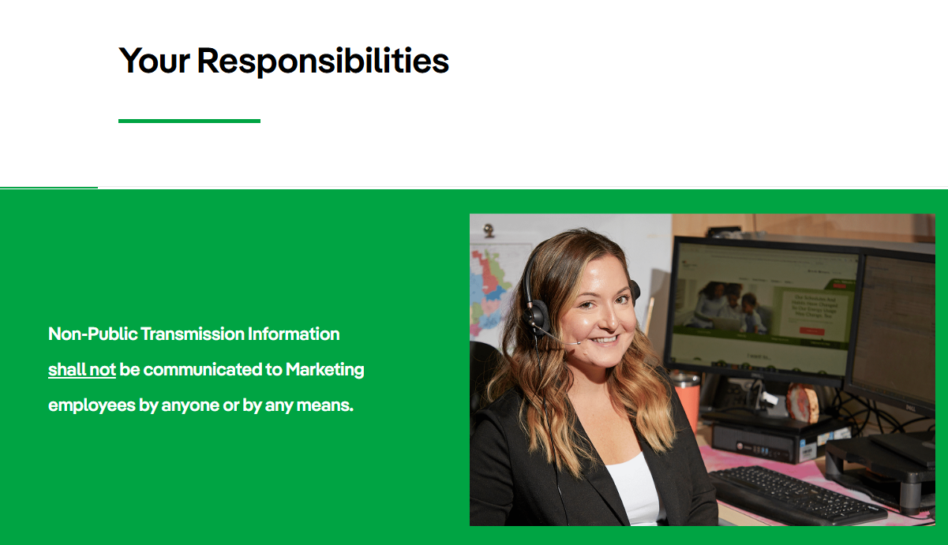

Slide 12
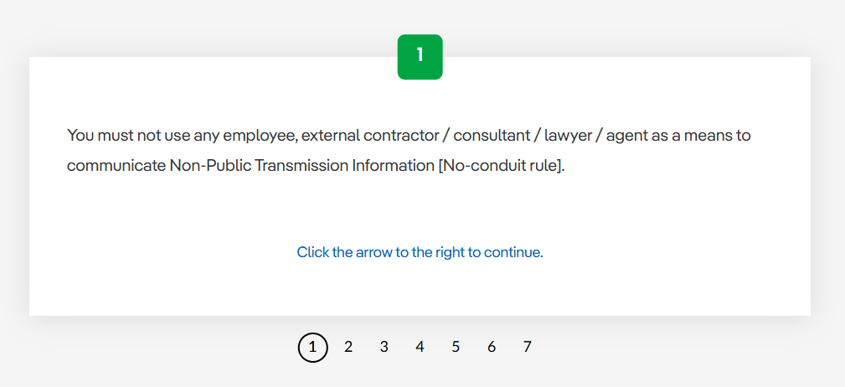
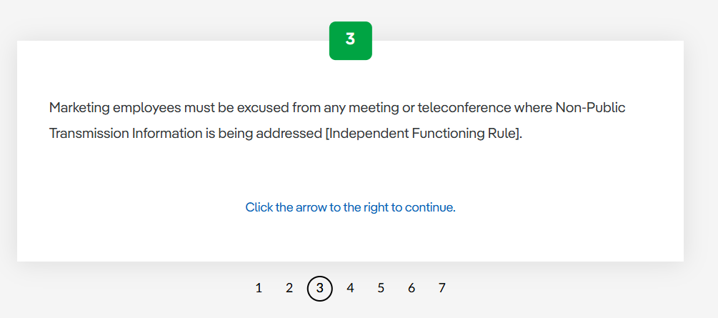
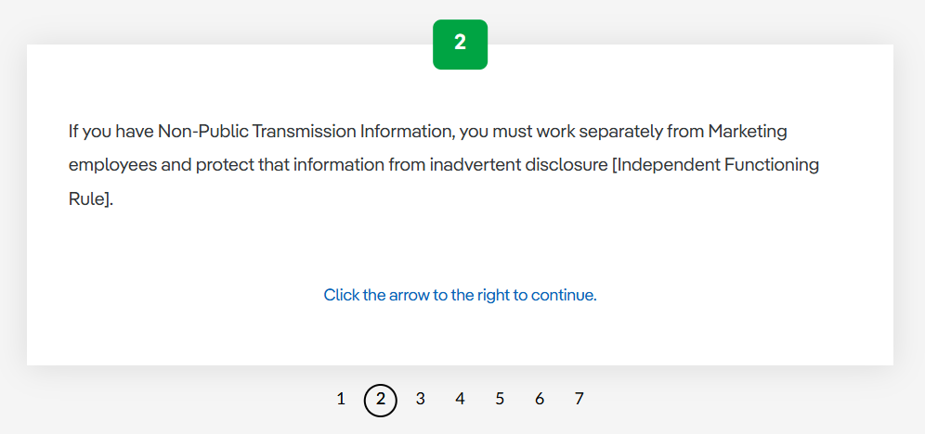
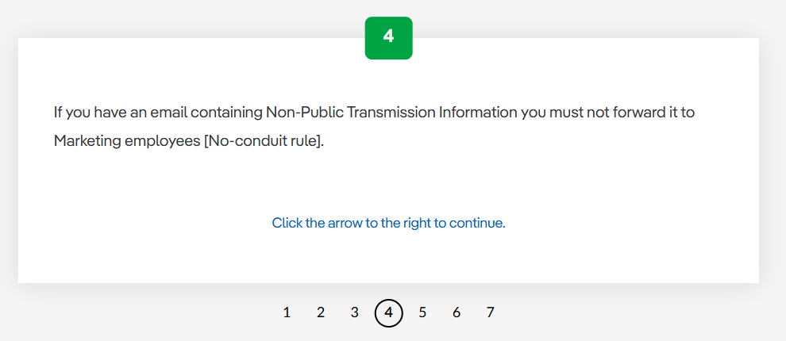

Slide 13
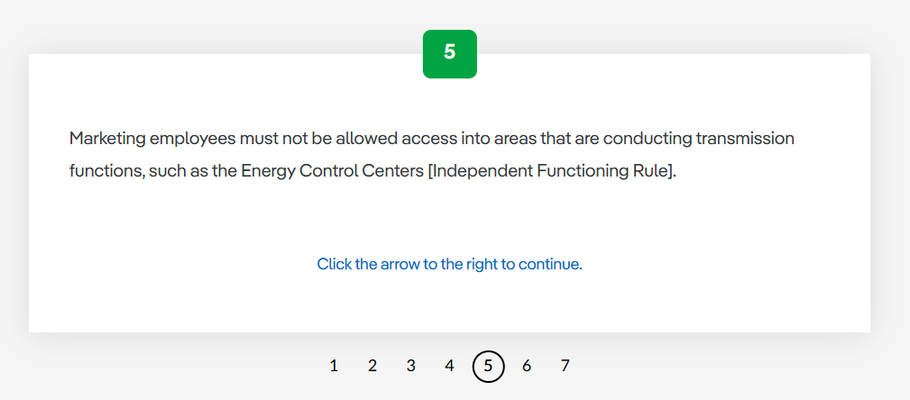
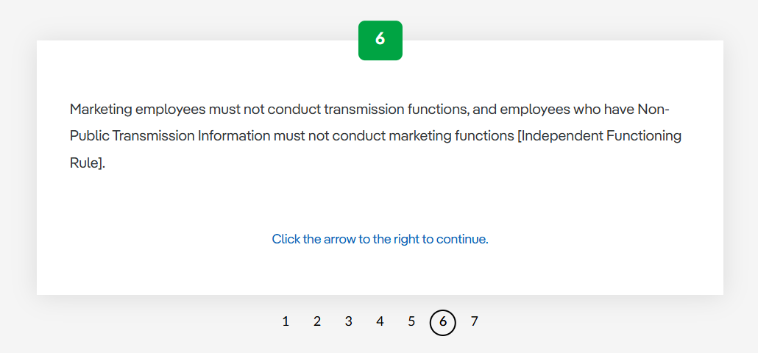
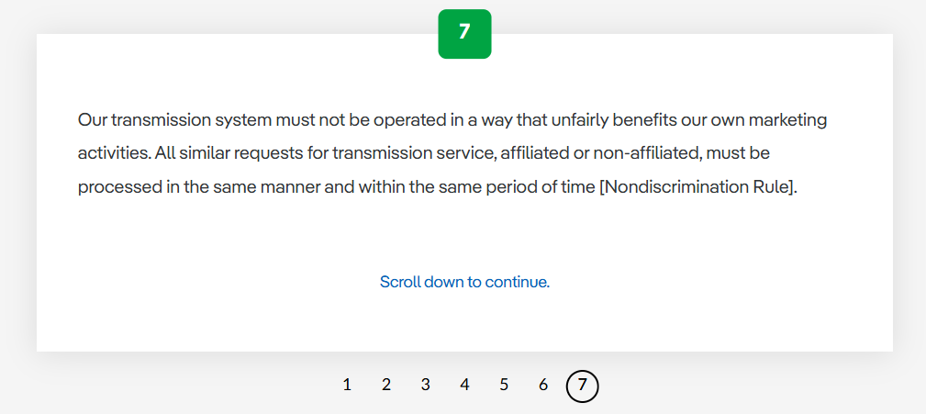

Slide 14
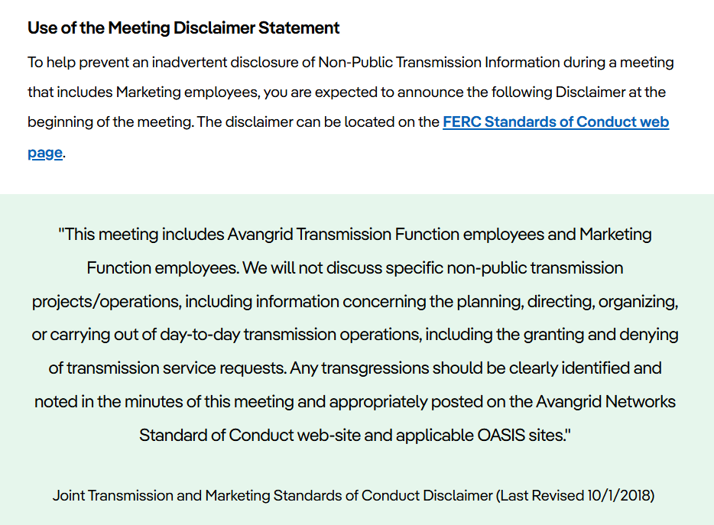

Slide 15


Slide 16
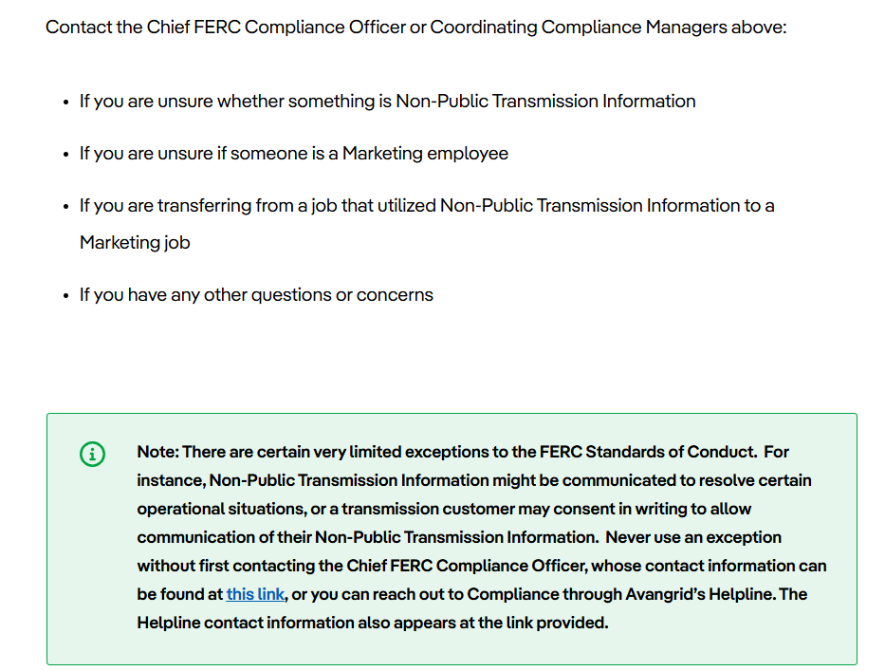

Slide 17
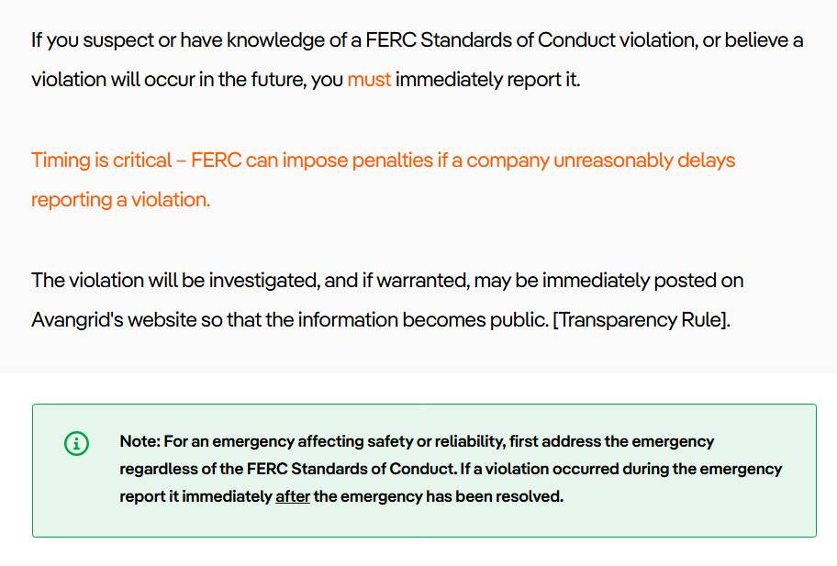

Slide 18
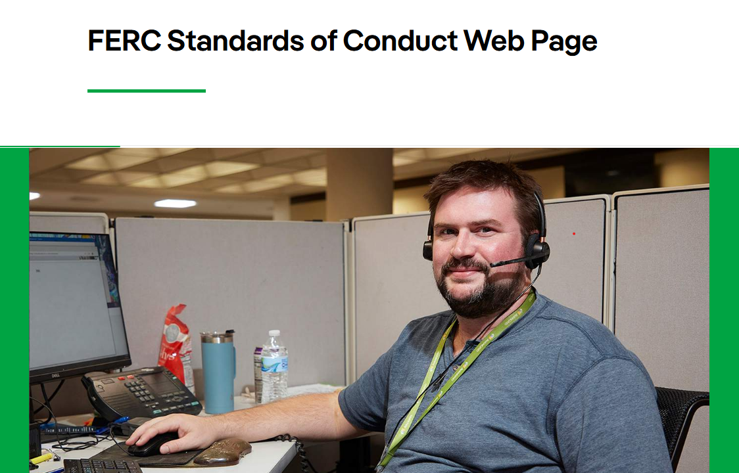

Slide 19
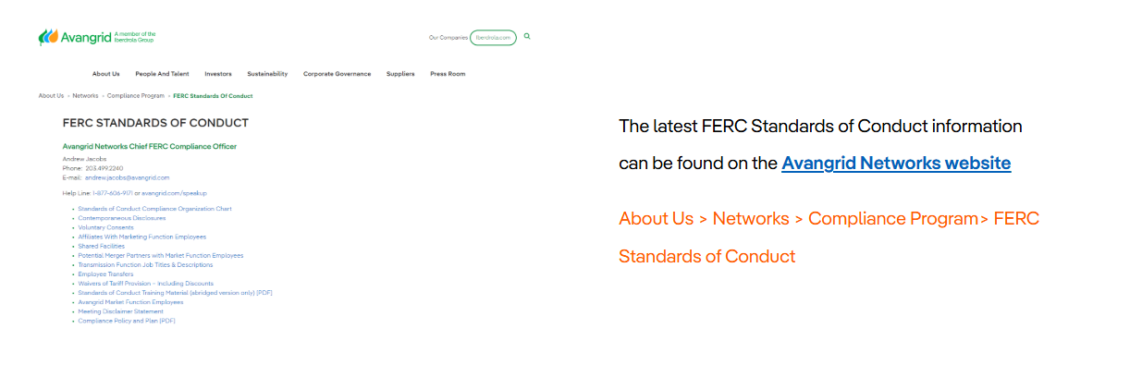

Slide 20
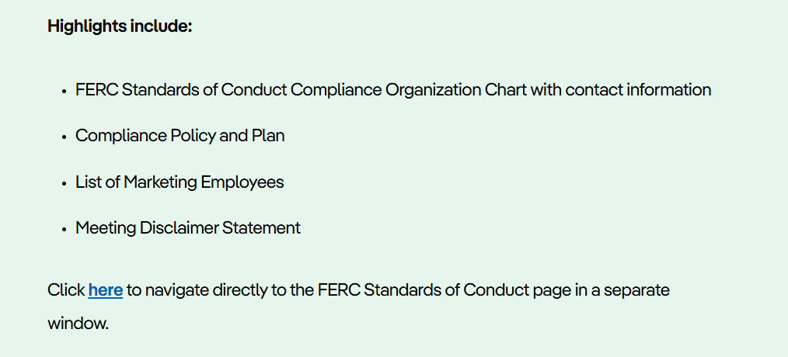

Slide 21


Slide 22
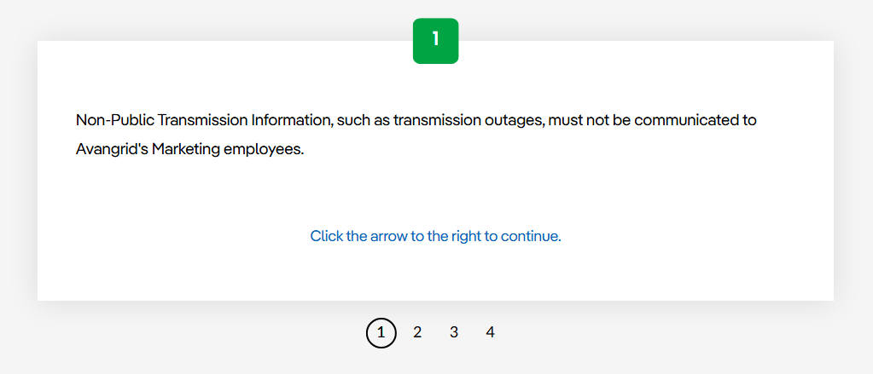
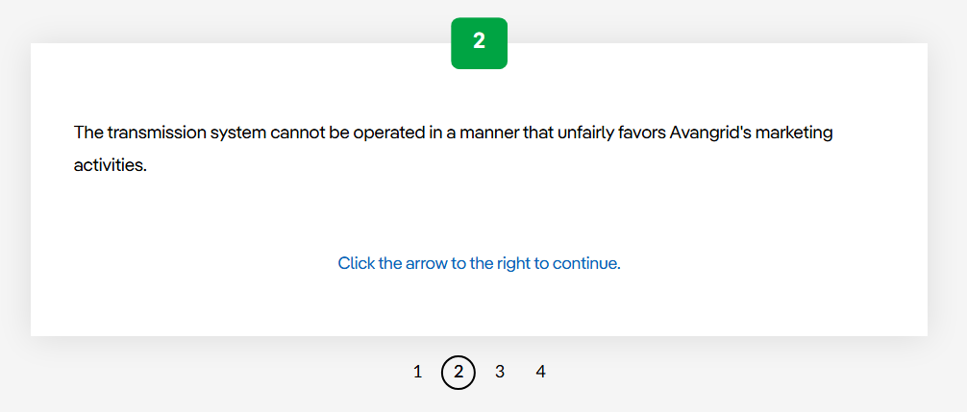
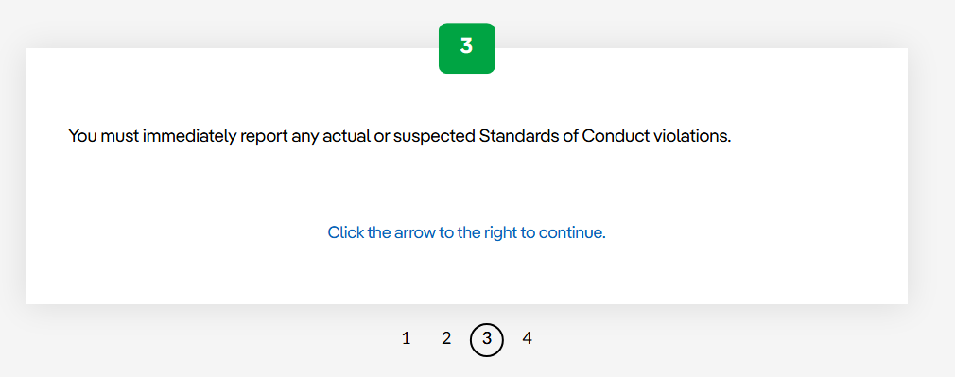
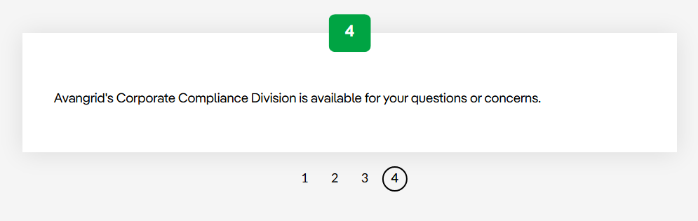

Slide 23
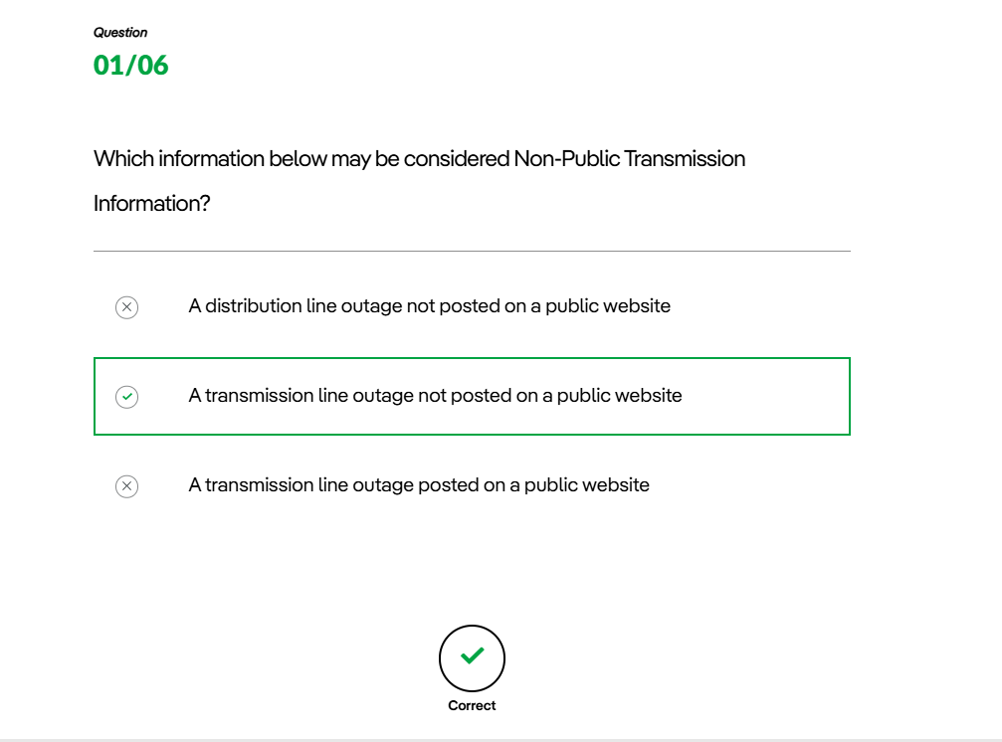

Slide 24
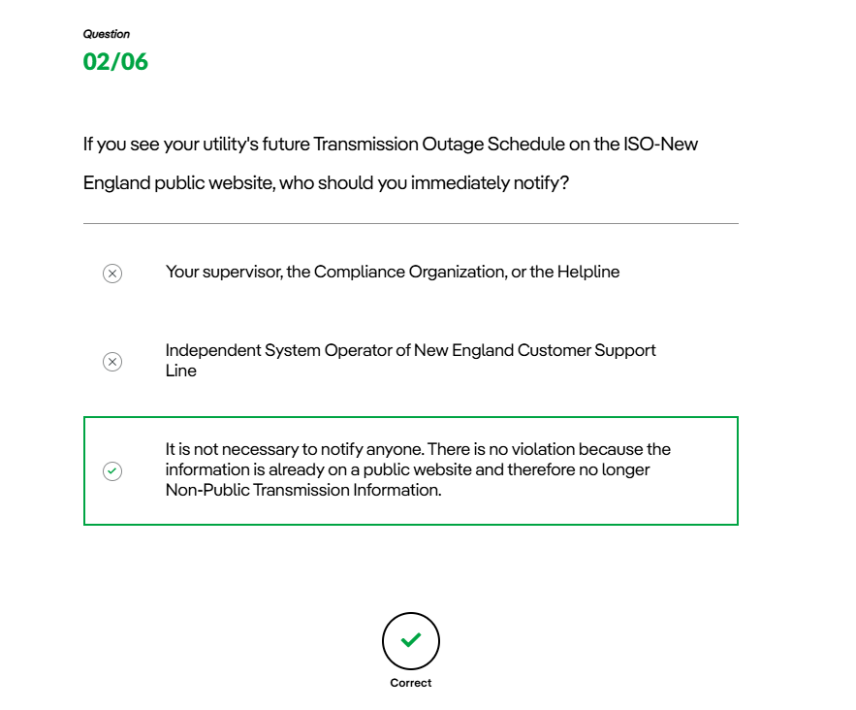

Slide 25
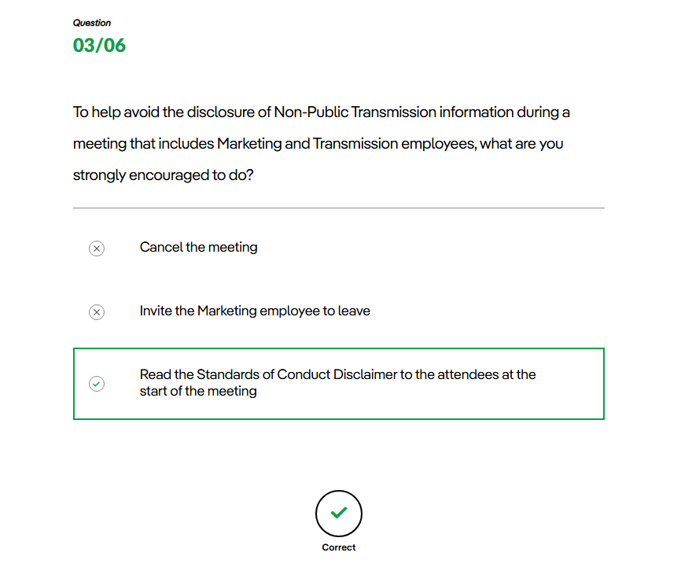

Slide 26
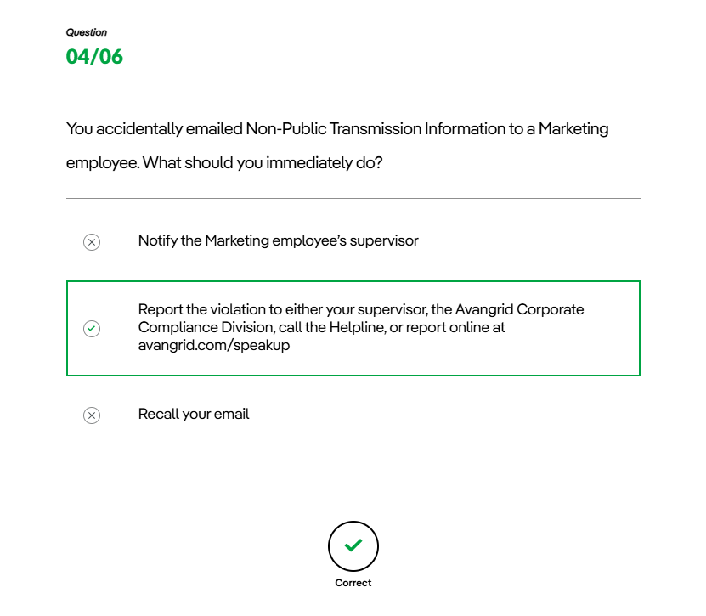

Slide 27
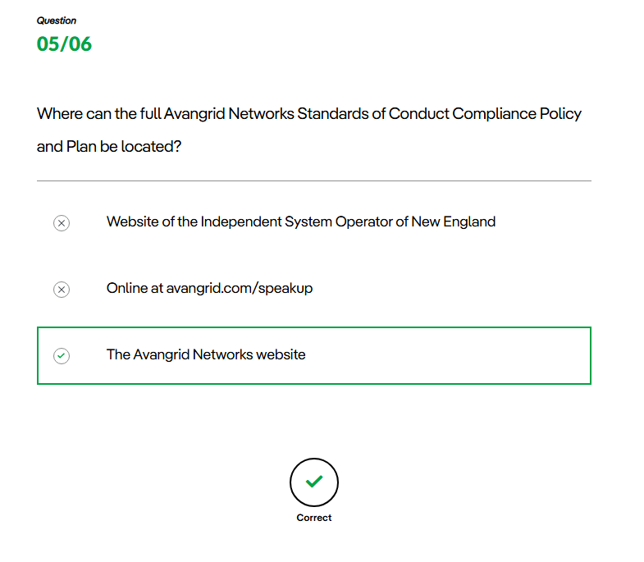

Slide 28
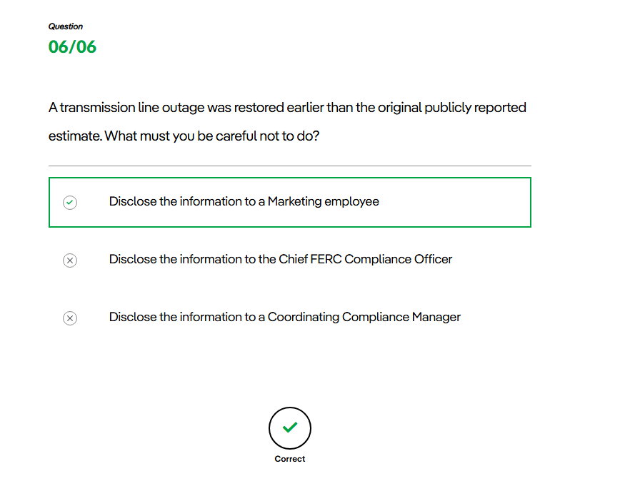

Slide 29
